Slide 1

Digital Ethics
Module XXX | Lesson Two: Libel and Privacy in Public Relations

Slide 2
“Commercial Speech”
Lesson Two | Libel and Privacy in Public Relations
Law generally considers both advertising and PR as “commercial speech,” since both are ultimately aimed at promoting commercial transactions
“Commercial speech” gets less protection under the First Amendment than other forms of speech (such as political speech)
Government can restrict or impose sanctions for some commercial speech, such as misleading (“false”) advertising or ads directed at children
The distinction between “commercial speech” and other forms of speech can sometimes be unclear
E.g., ads or press releases addressing political issues

Slide 3
Defamation (Libel)
Lesson Two | Libel and Privacy in Public Relations
Defamation is a legal claim for a statement that harms someone’s reputation.
Traditionally, there are two forms: libel (written) and slander (spoken).
Under 18th Century law, any statement that harmed someone’s reputation could be defamatory, even if the statement was true.
In the 19th Century most states changed this to require that the statement had to be false
The U.S. Supreme Court made major changes to defamation law in New York Times v. Sullivan (1964) and subsequent cases.

Slide 4
Defamation (Libel)
Lesson Two | Libel and Privacy in Public Relations
In Sullivan, the U.S. Supreme Court held that to win a defamation case, public officials must show that the speaker acted with “actual malice”
“actual malice” means that the speaker made the statement either knowing that it was false or with “reckless disregard” whether it was true or not
Within a few years, this requirement was also applied to well known people: “public figures.”
The “actual malice” requirement does NOT apply in cases brought by “private figures unless they seek punitive damages

Slide 5
Defamation (Libel)
Lesson Two | Libel and Privacy in Public Relations
After Sullivan and later cases, the requirements for a defamation case are:
For all Plaintiffs:
Publication: defendant published statement to third party
Identification: statement was about ("of and concerning") the plaintiff(s)
Defamation: statement was defamatory (actual harm may be required)
Other requirements vary by type of plaintiff(s) and nature of issue in the statement:
 | Public Official or Public Figure | Private Figure
Matter of Public Concern | Falsity: plaintiff must show that statement was false Fault: plaintiff must show "actual malice” | Falsity: plaintiff must show that statement was false Fault: for compensatory damages, state sets standard, which must be at least negligence; for punitive damages, plaintiff must show “actual malice” (in some states these requirements vary depending on whether the defendant is a media or non-media entity)
Matter of Private Concern | Falsity: plaintiff must show that statement was false Fault: plaintiff must show "actual malice” | Falsity: falsity presumed but may be rebutted by defendant Fault: state sets standard (but not strict liability)

Slide 6
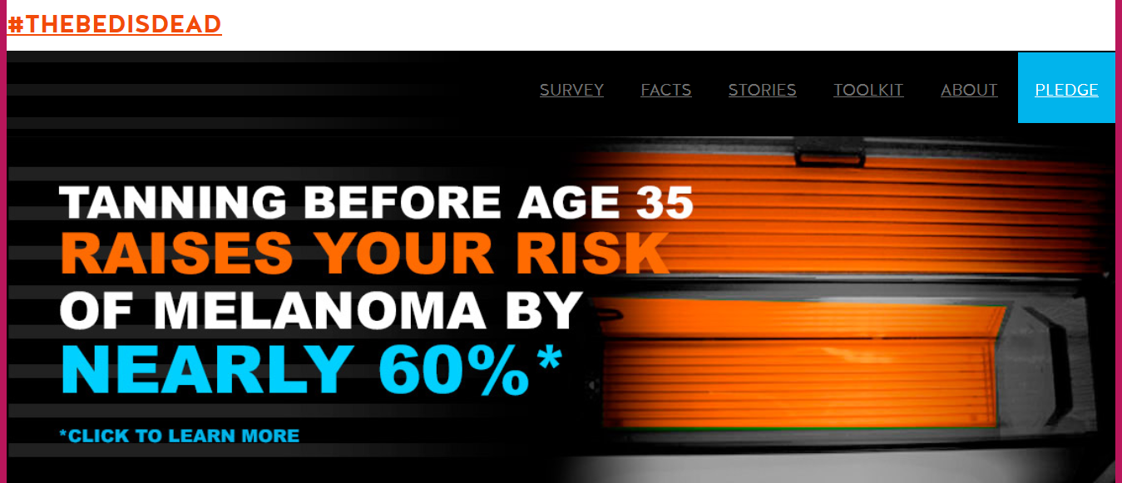
Case Study 1: JB & Associates, Inc. v. Nebraska Cancer Coalition
Lesson Two | Libel and Privacy in Public Relations
The Nebraska Cancer Coalition’s “The Bed is Dead” campaign sought to explain cancer risks associated with indoor tanning.
The campaign featured the site thebedisdead.org and social media posts.
Seven companies that operated tanning salons sued, claiming that the statements regarding the dangers of tanning were false and defamatory, and hurt their businesses.

Slide 7
Case Study 1: JB & Associates, Inc. v. Nebraska Cancer Coalition
Lesson Two | Libel and Privacy in Public Relations
Is this defamation?

Slide 8
Lesson Two | Libel and Privacy in Public Relations
Case Study 1: JB & Associates, Inc. v. Nebraska Cancer Coalition
The trial court judge dismissed the lawsuit, holding that the statements on the BedIsDead website were about tanning generally, not about plaintiffs’ specific businesses and their services.
The Nebraska Supreme Court affirmed, holding that “there were insufficient facts to show recipients of [the] statements understood or should have understood the statements referred or were intended to refer to appellants.”

Slide 9
Case Study 2: JB & Associates, Inc. v. Nebraska Cancer Coalition
Lesson Two | Libel and Privacy in Public Relations
DISCUSSION QUESTIONS:
The very nature of the “Bed is Dead” campaign set it against the business interests of businesses that offered interior tanning services. Was there any way to avoid this conflict? Any way to avoid it going to court? Would it have been better to consult and negotiate with the tanning salons before launching the campaign, or would that have undermined the campaign’s message?

Slide 10
Fair Use
Lesson Two | Libel and Privacy in Public Relations
“Fair use” allows limited use of copyrighted material without the copyright holder’s permission for certain purposes.
In considering whether a particular use of a copyrighted work is “fair use,” courts consider the following:
the purpose and character of the use, including whether such use is commercial or for nonprofit educational purposes;
the nature of the copyrighted work;
the amount and substantiality of the portion of the work used;
the effect on the market or value of the copyrighted work.

Slide 11
Privacy
Lesson Two | Libel and Privacy in Public Relations
Privacy law is concerned with the collection, retention and dissemination of information about individuals.
The concept of privacy in the law was introduced in the 1890s.
The have traditionally been few laws regarding information held by private entities. But the growing business of using personal information for commercial purposes had led to new laws and regulations.
There is no general federal privacy law, but many states have adopted their own such laws.
Outside the U.S., the European Union has adopted extensive privacy laws and regulations.

Slide 12
Privacy
Lesson Two | Libel and Privacy in Public Relations
States have generally recognized four types of privacy claims:
Intrusion: Unauthorized physical entry to a location where the plaintiff had a reasonable expectation of privacy. Also allowed when a defendant psychologically intrudes on a person’s personal, private realm in which the victim has a “reasonable expectation of privacy.”
Dissemination of Private Facts: Public revelation of information about the plaintiff that has not been widely revealed.
Appropriation / Misappropriation / Right of Publicity: Use of someone’s image or identity (e.g., voice) for commercial purposes without permission.
False Light: Dissemination of information about plaintiff that is truthful, but is conveyed in a way or context that conveys a false impression.

Slide 13
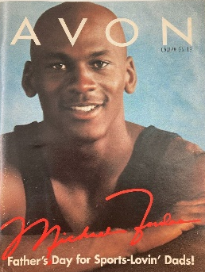
Case Study 2: Michael Jordan’s Lawsuits
Lesson Two | Libel and Privacy in Public Relations
In addition to being a legendary basketball player, Michael Jordan is also a savvy businessman who has earned hundreds of millions of dollars by licensing his name and image.
In 1997 Jordan sued Avon cosmetics and watch-maker M.Z. Berger & Co. over a catalogue that featured him and his signature on the cover and offered a Michael Jordan watch. Jordan had authorized the watch, but not the marketing campaign with Avon. He ended up settling with both companies for undisclosed sums.

Slide 14
Case Study 2: Michael Jordan’s Lawsuits
Lesson Two | Libel and Privacy in Public Relations
Sports Illustrated published a commerative issue to celebrate Jordan’s induction into the Basketball Hall of Fame in 2009. Two competing Chicago-area supermarket chains, Dominick’s Finer Foods and Jewel–Osco, had ads in the issue.
The Jewel–Osco ad featured a pair of basketball shoes with Jordan’s number with the Chicago Bulls, 23. The Dominick’s ad featured the number 23 in colors that mimicked the Bull’s “away” uniforms and a silhouette of a player dunking a basketball, reminiscent of the trademarked “Air Jordan” logo. At the bottom was a for a ”Rancher’s Reserve” steak.

Slide 15
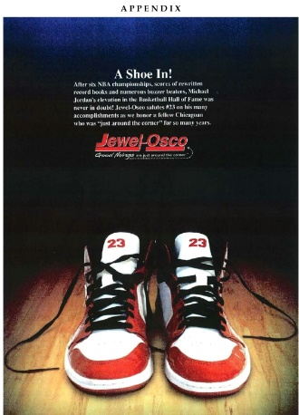
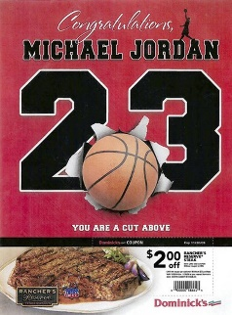
Case Study 2: Michael Jordan’s Lawsuits
Lesson Two | Libel and Privacy in Public Relations

Slide 16
Case Study 2: Michael Jordan’s Lawsuits
Lesson Two | Libel and Privacy in Public Relations
The issue had many such ads. But Jordan sued over the two supermarkets’ ads, saying that they “didn't fit the strategy.”
In addition to both being for businesses that Jordan may not have wanted to be associated with, the coupon could compete with Jordan’s steakhouses.
“This shows I will protect my name to the fullest,” Jordan said. “It’s my name and I worked hard for it, ... and I’m not just going to let someone take it.”
Is this a good misappropriation claim?

Slide 17
Case Study 2: Michael Jordan’s Lawsuits
Lesson Two | Libel and Privacy in Public Relations
A federal trial judge initially dismissed Jordan’s lawsuit against Jewel–Osco, ruling that the ad was not commercial speech because it did not propose a business transaction. But and appeals court reversed, holding that it was commercial speech because it was “aimed at promoting store's brand and enhancing consumer goodwill.”
The case was sent back to the trial court, which held that the ad had violated Jordan’s right of publicity, and in August 2015 a jury awarded Jordan $8.9 million.
Jordan said that he would give the jury award to charity. “This was never about the money,” he said.
Jewel–Osco filed a motion to get the damages award reduced. Meanwhile, the lawsuit against Dominick’s was scheduled for trial on December 2015.
But two weeks before that trial was to begin, Jordan announced that he had reached a confidential settlement of both lawsuits, and that the settlement amount would be donated to charity.

Slide 18
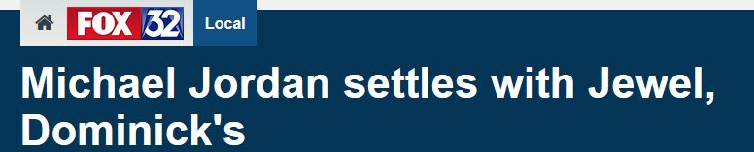
Case Study 2: Michael Jordan’s Lawsuits
Lesson Two | Libel and Privacy in Public Relations
Jewel–Osco filed a motion to get the damages award reduced. Meanwhile, the lawsuit against Dominick’s was scheduled for trial on December 2015.
Two weeks before that trial was to begin, Jordan announced that he had reached a confidential settlement of both lawsuits, and that the settlement amount would be donated to charity.

Slide 19
Case Study 2: Michael Jordan’s Lawsuits
Lesson Two | Libel and Privacy in Public Relations
DISCUSSION QUESTIONS:
The supermarket’s ads were like many others in the issue. Could they have anticipated the lawsuit? Was it fair for Jordan to sue them and not the others?

Slide 20
A Final Thought…
Lesson Two | Libel and Privacy in Public Relations
The law has some ways of dealing with massive users of copyrighted works. For example, radio stations and streaming services pay a licensing fee for unlimited usage of copyrighted music. Should a similar scheme be put in place for websites and services that frequently use copyrighted works?

