Slide 1

Copyright Law and Public Relations

Slide 2
“Commercial Speech”
Lesson One | Copyright Law and Public Relations
Law generally considers both advertising and PR as “commercial speech,” since both are ultimately aimed at promoting commercial transactions
“Commercial speech” gets less protection under the First Amendment than other forms of speech (such as political speech)
Government can restrict or impose sanctions for some commercial speech, such as misleading (“false”) advertising or ads directed at children
The distinction between “commercial speech” and other forms of speech can sometimes be unclear
E.g., ads or press releases addressing political issues

Slide 3
Importance of Copyright Law
Lesson One | Copyright Law and Public Relations
Copyright law protects creative works from unauthorized use
As a content creator, all of the work you create is protected by copyright law
If work is created for a client or an employer, they own the copyright
You own the copyright of any work that you create by and for yourself
While it is technologically easy to “cut and paste” material found online, doing so is usually copyright infringement
As a content creator, you should respect the legal rights in the content created—and owned—by others, just as you would want your work to be similarly respected

Slide 4
Copyright Law Basics
Lesson One | Copyright Law and Public Relations
Copyright protects particular expression of an idea; but NOT the idea itself.
A copyright exists immediately upon creation of a work; no formal action is required.
Copyright in a work belongs the creator(s) of that work, unless it is a “work for hire”
A copyright owner decides whether or not to allow others to use the work.
The “Creative Commons” scheme is a standardized way for a creator to allow/disallow certain uses.
Copyright protection lasts 70 years after death for a work by a single author, 95 years for a work owned by a corporation.

Slide 5
Copyright Law Basics
Lesson One | Copyright Law and Public Relations
After the copyright for a work expires, that work is in the “public domain” and anyone can use it.
But some copyrighted works, such as images, may also be protected as a trademark. Trademark protection can be renewed, in 20 year increments, indefinitely.
Just because something is posted online does not mean that it is not protected by copyright.
“Cutting and pasting” something found online and using it without the copyright owner’s permission is illegal copyright infringement.

Slide 6
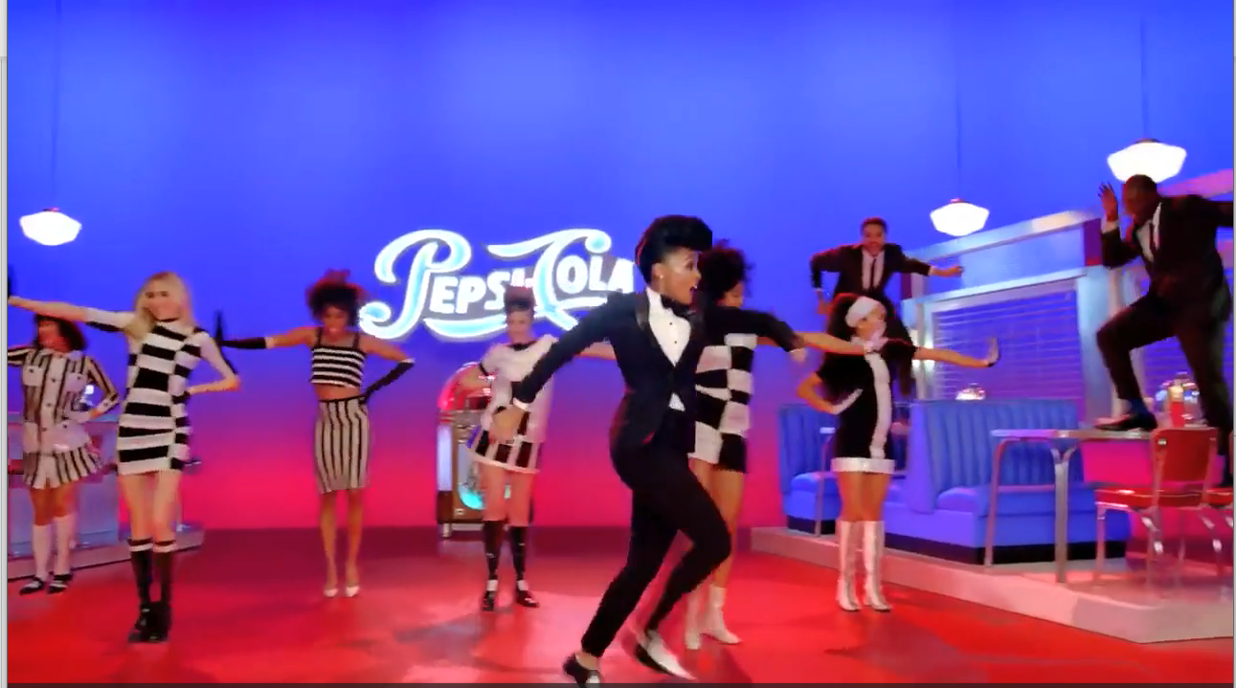
Case Study 1: Betty, Inc. v. Pepsico, Inc.
Lesson One | Copyright Law and Public Relations
An agency proposed a Pepsi Superbowl ad going through rooms of a warehouse with musicians playing Pepsi’s theme song in various genres.
The eventual ad—from another agency—featured a singer going through areas with crowds dancing to music of the 1950s, 1980s and 2000s, with costumes of each era.
Is this copyright infringement?

Slide 7
Lesson One | Copyright Law and Public Relations
Case Study 1: Betty, Inc. v. Pepsico, Inc.
Is this copyright infringement?
NO
Court held that while the final ad was similar to the ad agency’s pitch, it was not infringement since an idea cannot be copyrighted
Do you agree? Is this ethical?

Slide 8
Case Study 1: Betty, Inc. v. Pepsico, Inc.
Lesson One | Copyright Law and Public Relations
DISCUSSION QUESTION:
The court held that Pepsi’s use of an ad similar to the proposal was not copyright infringement. But was it ethical? Do law and ethics always reach the same result?

Slide 9
Fair Use
Lesson One | Copyright Law and Public Relations
“Fair use” allows limited use of copyrighted material without the copyright holder’s permission for certain purposes.
In considering whether a particular use of a copyrighted work is “fair use,” courts consider the following:
the purpose and character of the use, including whether such use is commercial or for nonprofit educational purposes;
the nature of the copyrighted work;
the amount and substantiality of the portion of the work used;
the effect on the market or value of the copyrighted work.

Slide 10
Fair Use
Lesson One | Copyright Law and Public Relations
“Fair use” is determined on a case-by-case basis, based on the factors outlined above.
The belief that using less than a certain number of words of a text or less than a certain length of a song or video is automatically “fair use” is wrong.
The use of a very small portion of a copyrighted work without permission can be infringement.

Slide 11
Fair Use
Lesson One | Copyright Law and Public Relations
Courts generally consider certain uses fair use, including news reporting; non-profit educational uses; and criticism, parody or satire.
An unauthorized use can also be “fair use” if the new use is “transformative:” it is a fundamentally new work that involves creativity so that it is not simply derivative of the prior copyrighted work.

Slide 12
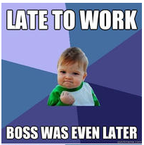
Case Study 2: “Success Kid” Lawsuits
Lesson One | Copyright Law and Public Relations
In 2007 Laney Griner posted a photo of her 11-month-old son Sam with a fistful of sand and a determined look on his face.
Various MySpace users posted the photo. One added another child in the background, surrounded by a ring of sand, with the superimposed text “I Hate Sandcastles.”
The photo became the “Success Kid” meme.
Griner licensed the photo for ads. But she sued a fireworks company that used the photo on packaging and a congressman who used it for campaign ads.

Slide 13
Case Study 2: “Success Kid” Lawsuits
Lesson One | Copyright Law and Public Relations
Is this copyright infringement?
YES
The fireworks lawsuit was settled, with the company agreeing not to use the photo in packaging or advertising.
In the campaign lawsuit a jury found that the infringement was done unknowingly and awarded $750, the minimum damages under the statute. Both sides have appealed.
Do you agree? Were these uses ethical?

Slide 14
Case Study 2: “Success Kid” Lawsuits
Lesson One | Copyright Law and Public Relations
DISCUSSION QUESTIONS:
Sam will forever be associated with the “Success Kid” meme. Is this fair to him? Was it ethical for his mother to license the image for commercial use? Should he have a say?

Slide 15
A Final Thought…
Lesson One | Copyright Law and Public Relations
The law has some ways of dealing with frequent users of copyrighted works. For example, bars and streaming services pay licensing fees for their large usage of copyrighted material (music, sports TV). Should a similar scheme be put in place for websites and services that frequently use copyrighted works?

