Slide 1

Introduction to Shareholder Activism
Alexander V. Laskin, Ph.D.
Lesson Two

Slide 2
Lesson Overview
Defining types of corporations
Defining types of ownership
Understanding corporate structure
Board of Directors
C-suite

Slide 3
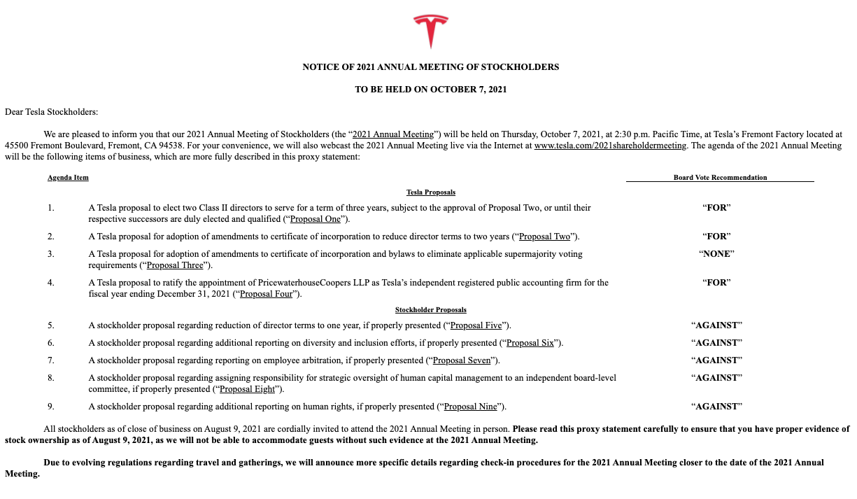

Slide 4
Corporations
Private
Public

Slide 5
Ownership
Equity securities
Ordinary
Preferred
Convertible
Debt securities

Slide 6
Discussion Question
What are the benefits for corporations to issue different types of securities?

Slide 7
Corporate Structure
Board of Directors
Independent directors
Election process
C-suite
NEOs

Slide 8
Discussion Question
Why was the new category of NEO created?

Slide 9
Discussion Question
Amazon Proposal #9
Tesla Proposal #9

Slide 10
In-class Activity
Get in pairs
Choose any large modern corporation
Propose an issue that can be a focus of shareholder activism
Develop a shareholder activism proposal
Provide rationale for other shareholders to approve it
Provide clear steps you want the company to take

Slide 11
Home Work
Write a corporate response to the shareholder activism proposal you drafted in class
Format the response as a memo from you, VP of Investor Relations, to the CEO of the company
Draft a public response to the shareholders and provide a rationale for such a response

Slide 12
Extra Readings
Lesson One | Introduction
Hamdani, A., & Hannes, S. (2021). Institutional investors, activist funds and ownership structure. In Comparative Corporate Governance. Edward Elgar Publishing.
Laskin, A.V. (2022). Investor relations and financial communication. Wiley.
Lee, C. (2021). Mitigating information imperfections in proxy contests: The effect of dissidents' proxy solicitation. Journal of Corporate Finance, 102011.
White, S., & Trejo-Pech, C. J. (2022). Farmer Brothers Company Proxy Contest: A Corporate Governance Case Study. International Journal on Food System Dynamics, 13(1), 85-99.

