Slide 1

Introduction to Shareholder Activism
Alexander V. Laskin, Ph.D.
Lesson One

Slide 2
Lesson Overview
Lesson One | Introduction
Defining Shareholder Activism
Understanding the concept of separation of management and ownership
Learning about different types of shareholders and their activism styles

Slide 3
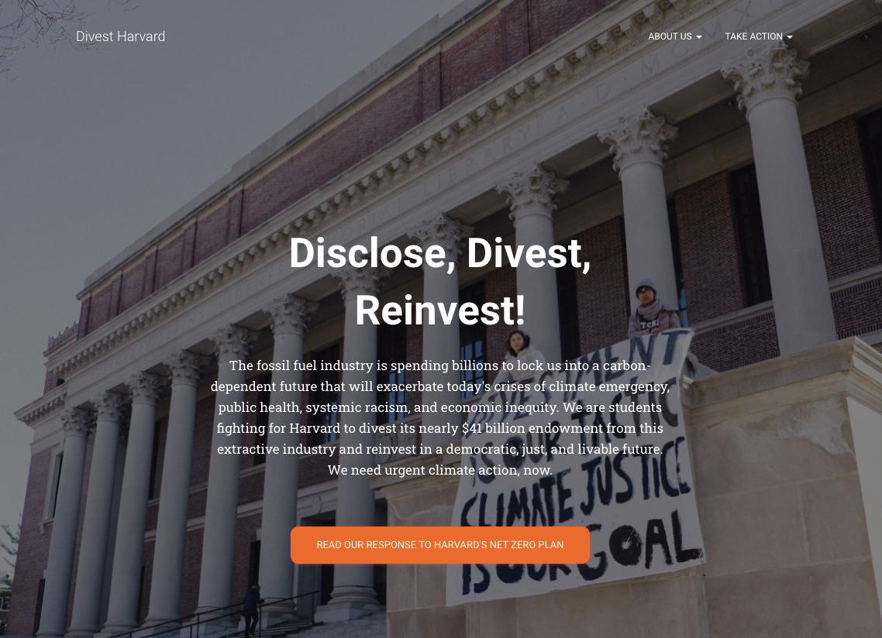

Slide 4
Modern Corporation
Lesson One | Introduction
From single craftsmen to family businesses to commenda to corporations
Pooling resources
Ownerships vs management
Limited liability
Risks and Rewards

Slide 5
Management
Agency Theory
Principal
Agent
Fiduciary Duty vs Self-Interest
Corporate Governance
Disclosure
AGM
Proxy

Slide 6
Shareholders
Lesson One | Introduction
Retail shareholders
Strategic investors
Portfolio investors

Slide 7
Discussion Question
Lesson One | Introduction
What do you think shareholders want?

Slide 8
Funds
Lesson One | Introduction
Mutual funds
Pension funds
Endowment funds
Hedge funds

Slide 9
Discussion Question
Lesson One | Introduction
Do you expect different priorities from different funds?

Slide 10
In-class Activity
Lesson One | Introduction
How about our University?
Get in groups of no more than 5 students
Identify key endowment facts:
Amount managed?
Who manages it?
Financial strategy?
Any ESG strategy, statements, positions?
Reporting process?
Compare the endowment strategy with the University’s statements focusing specifically on the ESG issues
Develop a proposal for the University to better align the endowment’s investments with the University’s priorities

Slide 11
Home Work
Lesson One | Introduction
Interview 5 students outside the class
What do they know about the university’s investments?
How much do they care about the university’s investments?
Where do they want university to invest in and where not to invest in, if it were up to them?

Slide 12
Extra Readings
Lesson One | Introduction
Fairfax, L.M. (2011). Shareholder Democracy: A Primer on Shareholder Activism and Participation. Carolina Academic Press.
Gramm, J. (2016). Dear Chairman: Boardroom Battles and the Rise of Shareholder Activism. Harper.
Walker, O. (2016). Barbarians in the Boardroom: Activist Investors and the battle for control of the world's most powerful companies. Pearson.
Solak, E. (2020). Shareholder Activism and the Law: The Future of US Corporate Governance. Routledge.

