Slide 1
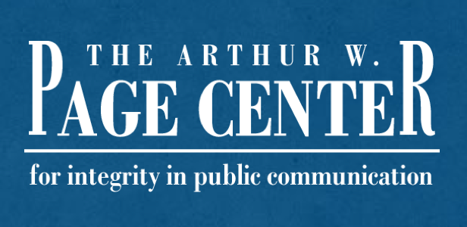
Introduction to Public Relations Ethics
Module One | Lesson Two

Slide 2
Lesson Overview
Lesson Two | Introduction
The Role of Trust in Ethics
Ethical Decision-Making Models
The State of Ethics in Public Relations

Slide 3
Understanding Trust
Lesson Two | Introduction
Trust is the cornerstone for long-term relationships between organizations and the public.
Public relations professionals must maintain trust from both the public and key stakeholders in order to fulfill their role.

Slide 4
Ethical Obligations and Models
Lesson Two | Introduction
The Attorney-Adversary Model
The Asymmetrical Model
The Symmetrical Model
The Professional Responsibility Model

Slide 5
Discussion Question One
Lesson Two | Introduction
“What is the impact to the role of a public relations professional when trust is lost either with a client or the public?”

Slide 6
Ethical Decision-Making Models
Lesson Two | Introduction
Models allow professionals to apply ethical reasoning in a variety of situations and contexts.
Certain models apply to specific situations like persuasive communication, issues management or organizational decisions.

Slide 7
Three Ethical Decision-Making Models
Lesson Two | Introduction
Bowens Model for Strategic Decision Making
TARES Ethical Persuasion
Potter’s Box for Decision Making

Slide 8
Discussion Question Two
Lesson Two | Introduction
“What is the value of having different decision-making models available for public relations professionals?”

Slide 9
The State of Ethics in Public Relations
Lesson Two | Introduction
Voice of Conscience Function in Senior Practitioners.
Organizational Practices and Ethical Counsel.
Education in Ethical Decision Making.
Millennials and Ethical Perspectives.

Slide 10
Discussion Question Three
Lesson Two | Introduction
“What things should public relations professionals do in order to be prepared to have a strong ethical voice in organizations?”

Slide 11
References
Lesson Two | Introduction
Bowen, S.A. (2004). A State of Neglect: Public Relations as ‘Corporate Conscience’ or Ethical Counsel. Journal of Public Relations Research. 20, pp. 271-296.
Curtin, P. A., Gallicano, T. and Matthew, K. (2011). Millennials’ Approaches to ethical decision making: A survey of young public relations agency employees. Public Relations Journal, 5(2), 1-22.
Neill, M. S. and Drumwright, M. E. (2012). “PR Professionals as Organizational Conscience.” Journal of Mass Media Ethics, 27 (4), pp. 220-234.

