Slide 1
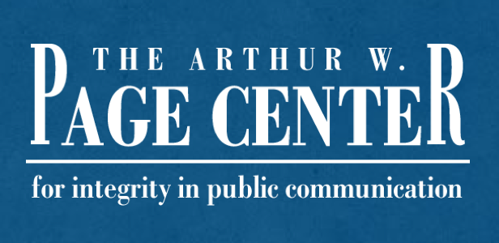
Introduction to
Public Relations Ethics
Module One | Lesson One

Slide 2
Lesson Overview
Lesson One | Introduction
Defining Ethics
Understanding Ethical Obligations in Public Relations
Developing an Ethical Profession

Slide 3
Defining Ethics
Lesson One | Introduction
Ethics: A decision making process to understand right from wrong.
Proper ethical choices among public relations professional has the potential to “foster community by creating, and maintaining mutually beneficial relationships” (Heath & Coombs, 2006)

Slide 4
Normative Ethical Systems
Lesson One | Introduction
Utilitarian Ethics: The greatest good for the greatest number.
Deontological Ethics: There are universal duties that are required of all humans, in all situations.
Virtue Ethics: The pursuit of the highest good, or virtues, in each situation or profession.

Slide 5
Discussion Question One
Lesson One | Introduction
“Out of the three major area within normative ethics (utilitarian, deontological, and virtue) which do you believe provides the strongest foundation for applied ethics in public relations and why?”

Slide 6
Obligations of the Profession
Lesson One | Introduction
Public relations professionals should have “unimpeachable ethical standards” the develop trust from clients and the public (Heath & Coombs, 2006).
“Every profession has a moral purpose. Medicine has health. Law has justice. Public relations has harmony—social harmony” (Seib and Fitzpatrick, 1995).

Slide 7
Obligations of the Profession
Lesson One | Introduction
Dedication to clients.
Commitment to the public.
Duty to the profession.

Slide 8
Mixed-Motive Obligations
Lesson One | Introduction
“Public relations professionals – as professionals – have obligations that extend beyond the profitability (however defined) of the organization represented. Responsibility to the public—or in the case of public relations, to multiple publics—must be balanced with responsibility to the client or employer.” Fitzpatrick & Gauthier (2001)

Slide 9
Discussion Question Two
Lesson One | Introduction
“What are the primary obligations of public relations professionals to clients, publics, and the profession?”

Slide 10
Developing an Ethical Profession
Lesson One | Introduction
Creation and growth of professional associations for public relations professionals.
Codes of ethics and influence on public relations professionals.

Slide 11
Discussion Question Three
Lesson One | Introduction
“Understanding the limitations of codes of ethics and associations within public relations, do you believe it is reasonable to assume there will be a universal code of conduct that will apply to all public relations professionals?”

Slide 12
References
Lesson One | Introduction
Fitzpatrick, K. & Gauthier, C. (2001). “Toward a Professional Responsibility Theory of Public Relations Ethics.” Journal of Mass Media Ethics, 16 (2-3), pp. 193-212.
Heath, R. & Coombs, W. (2006). Today's public relations an introduction. Thousand Oaks, Calif: SAGE Publications.
Seib, P. & Fitzpatrick, K. (1995). Public relations ethics. Fort Worth, TX: Harcourt Brace College Publishers.

