Slide 1

INTRODUCTION TO CONSCIOUS CAPITALISM
Module Eight | Lesson Two

Slide 2

“Profit for business is like oxygen for people:
if you don't have enough of it, you're out of the game.
However, if you think your life is about breathing
you've clearly missed something.”
-Peter Drucker

Slide 3
What is Conscious Capitalism?
Lesson One | Introduction
An emerging economic system that “builds on the foundations of capitalism—voluntary exchange, entrepreneurship, competition, freedom to trade and the rule of law. (consciouscapitalism.org)

Slide 4
Main Contribution
Lesson One | Introduction
A philosophical realignment of free-market principles with progressive business practices by stressing the profit-making potential of responsible, ethical, and sustainable corporate behavior.

Slide 5
Discussion Question
Lesson One | Introduction
Can profit lead to social good?

Slide 6
Virtue and Profit
Lesson One | Introduction
“[A business] cannot be seen as acting solely in
self interest, but rather must execute on both the fundamentals of profit and social good.”
–Edelman Trust Barometer

Slide 7
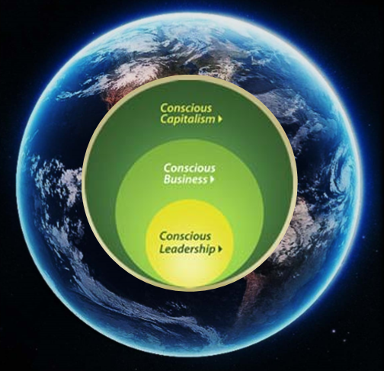
Conscious Capitalism Model
Lesson One | Introduction

Slide 8
Discussion Question
Lesson One | Introduction
How Does Conscious Capitalism Differ from CSR?

Slide 9
Conscious Capitalism vs. CSR
Conscious Capitalism
CSR
Serves the needs and concerns of all stakeholders
Ecosystem economy approach
Focuses on impact maximization
Incorporates higher purpose and a caring culture
Reconciles caring and profitability
Views business as a complex, adaptive system
Shared seeing and common will
Learning from the past and emerging future
Greater citizen awareness and participation
Views social responsibility as a trade-off between profit and social good
Independent of corporate purpose or culture
Adds an ethical burden to business
Often grafted onto traditional business model, usually as a separate department or part of public relations
Sees limited overlap between business and society

Slide 10
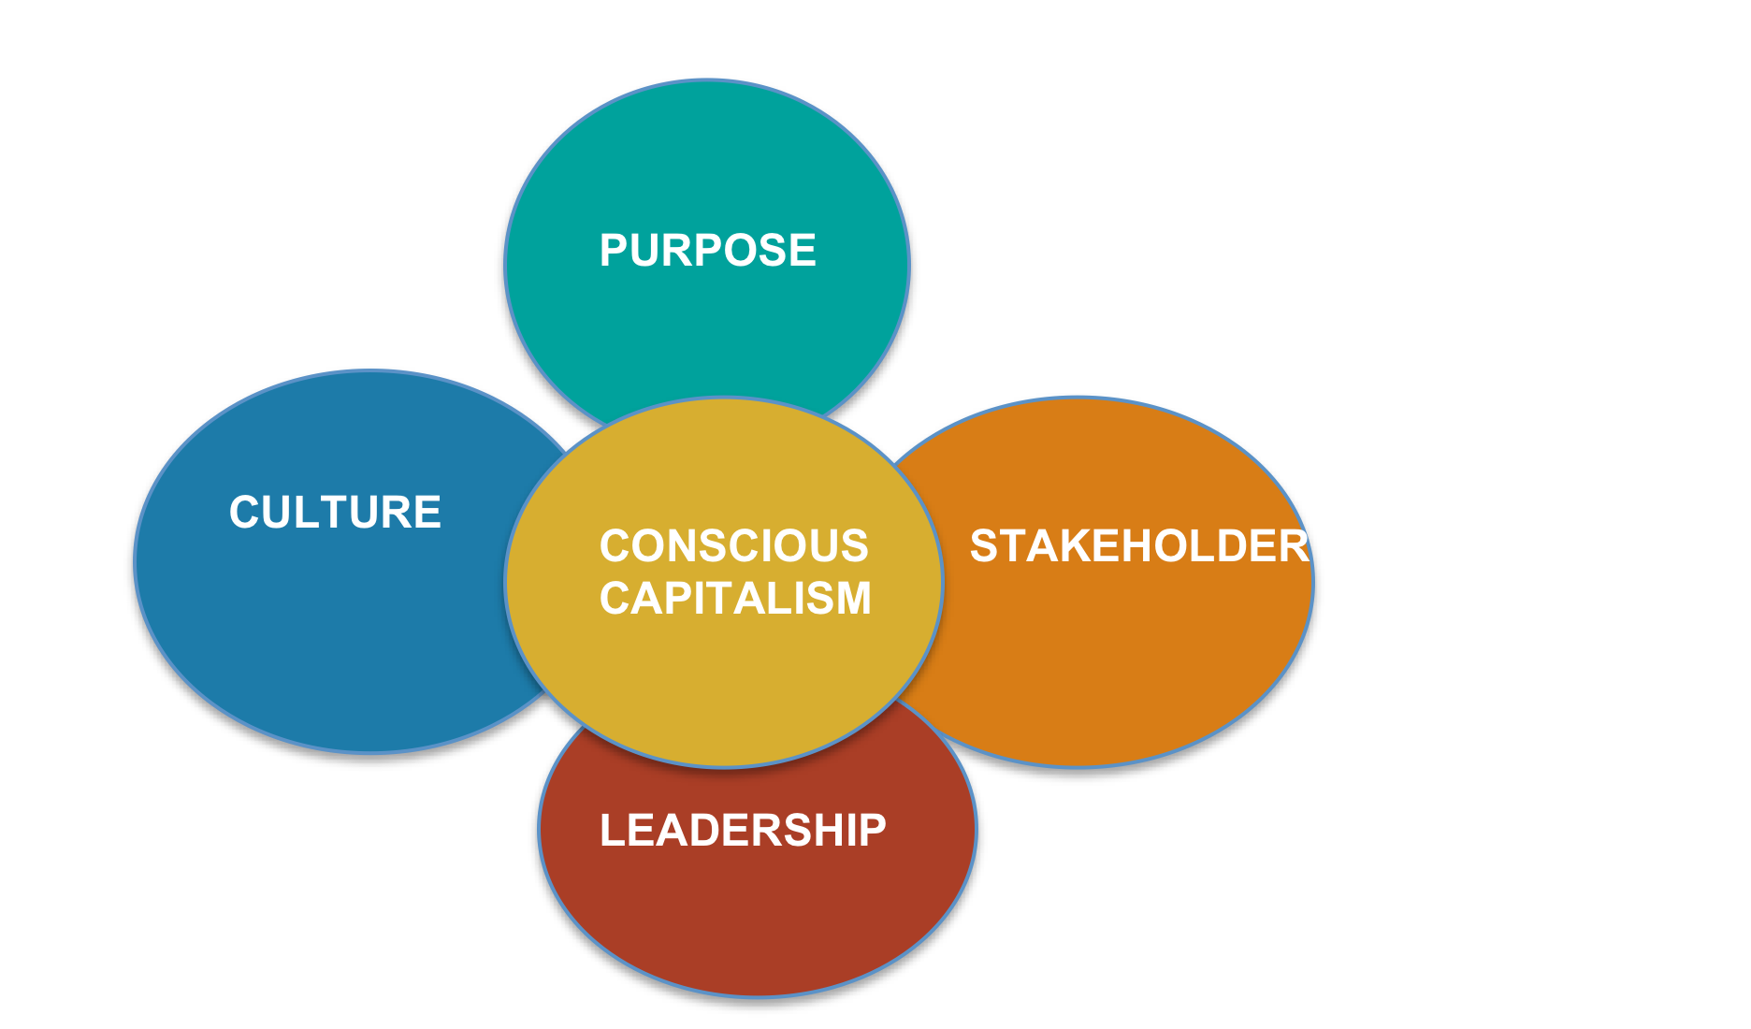
Core Tenets of a Conscious Business
Lesson One | Introduction
Transcendent
Value Creation For Audience
Self‐effacing Servant
Leader
Tactile

Slide 11
Purpose
Lesson One | Introduction
Transcends profit motive
Non‐financial reason for existence

Slide 12
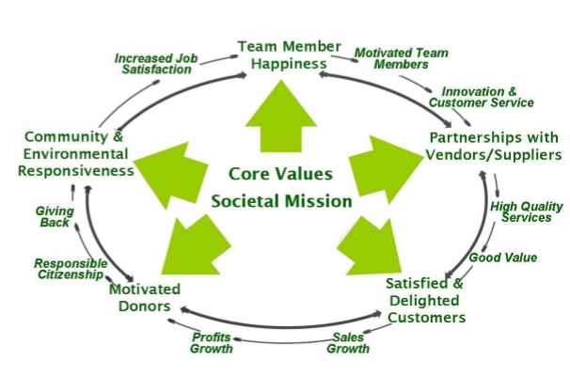
Stakeholders
Lesson One | Introduction

Slide 13
Conscious Culture
Lesson One | Introduction
TACTILE
Trust
Accountability
Caring
Transparency
Integrity
Loyalty
Egalitarianism

Slide 14
Discussion Question
Lesson One | Introduction
What should be the role of ethics in Conscious Capitalism?

Slide 15
Lesson One | Introduction
TACTILE
The word “tactile” also suggests that the cultures of these companies are very tangible to their stakeholders as well as to outside observers; you can feel the difference when you walk into a conscious business versus one that is purely driven by a profit motive and run just for the benefit of shareholders.

Slide 16
Servant Leadership
Lesson One | Introduction
Listening
Empathy
Healing
Awareness
Persuasion
Foresight
Stewardship
Commitment to
Growth of People
Building Community

Slide 17





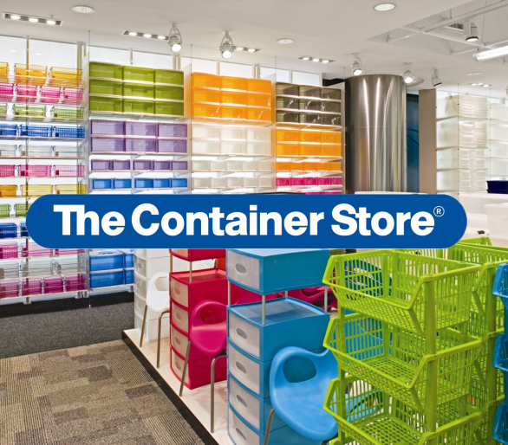
Exemplary Companies
Lesson One | Introduction

Slide 18
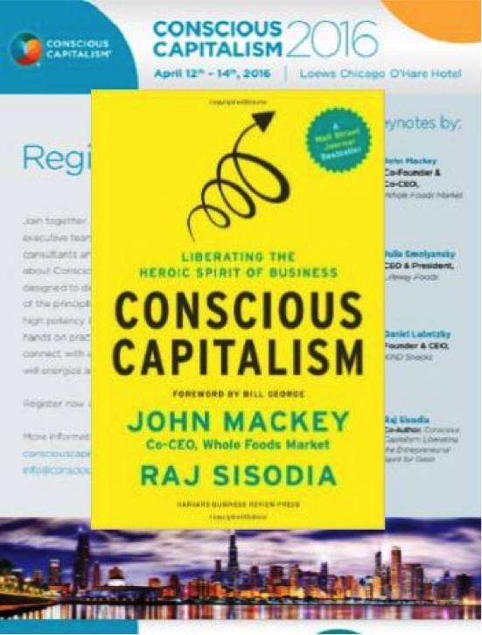
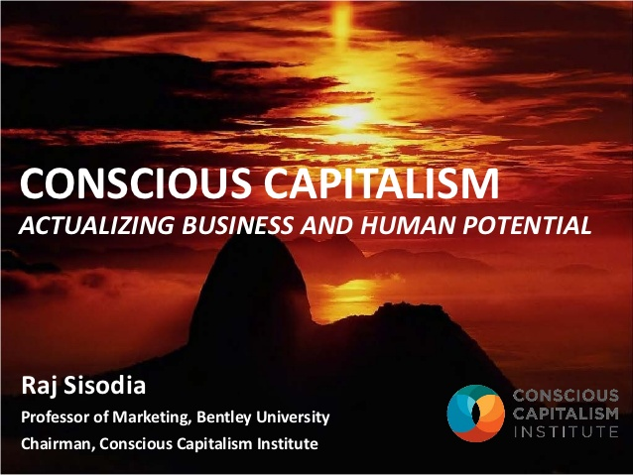
Conscious Capitalism Resources

